Slide 1
YOGYA outing SURVEY 2013

Slide 2
Yogya Survey Sharing
AGENDA
Central Idea and Lines of Inquiry
Where We are in Place and Time
How We Express Ourselves
Reasons why we chose Jogjakarta
Places to visit, transportation, and accommodation
Risk analysis

Slide 3
Planning
5 days
Monday morning to Friday night
28th October– 1st November, 2013
By Sancaka Train and Gege buses
Jogja Plaza Hotel Jogyakarta, Jalan Gejayan Yogyakarta

Slide 4
Where we are in place and time
An inquiry into orientation in place and time; personal histories, homes and journeys, discoveries, explorations, and the interconnectedness of individuals.
Central Idea
Our way of life reflects past civilizations
Lines of Inquiry
Evidence of past civilizations in societies
The connection between past civilizations to present lives
Implications for the future

Slide 5
How we express ourselves
An inquiry into the ways in which we discover and express ideas, feelings, nature, culture, beliefs and values. The ways in which we reflect on, extend and enjoy our creativity and our appreciation of the aesthetic
Central Idea
Creating and responding to art develops understanding of ourselves and the world around us.
Lines of Inquiry
How arts can be a reflection of societal values and issues
The contexts in which artworks were created
Personal preference in appreciation and creation of arts
How learning about arts develops appreciation

Slide 6
why is THE PYP 6 outing (jogyakarta) important?
It’s a school program to support the exploration of the unit
It includes development stages to support student’s skills and attitudes.

Slide 7
Reasons FOR Choosing Jogjakarta
The next Jogya outing will be applied to the unit of ‘Where We are in Place and Time’ that can help students understand the importance to preserve the heritage of Indonesian culture.
Students really need to learn a real situation and see role models that we can only find it in Jogya. There they can interact with primary resources such as artists and government officers who deal with Jogya cultural conservation.
The Jogya outing is a source for student learning to understand the changing from the past to the present civilization and how to preserve Indonesian heritage.

Slide 8
The Learning Expectations
Students develop a sense of independence and self-management for their learning
Students explore and experience Jogjakarta culture and history through art activities in a modern and cultural context
Students observe how Jogjakarta people preserve their culture and exhibit it in their present lives
Students grow and develop appreciation for their own culture
Students identify and observe art forms as inspiration for creating art
Students work and directly interact with artists

Slide 9
MAIN activities

Slide 10
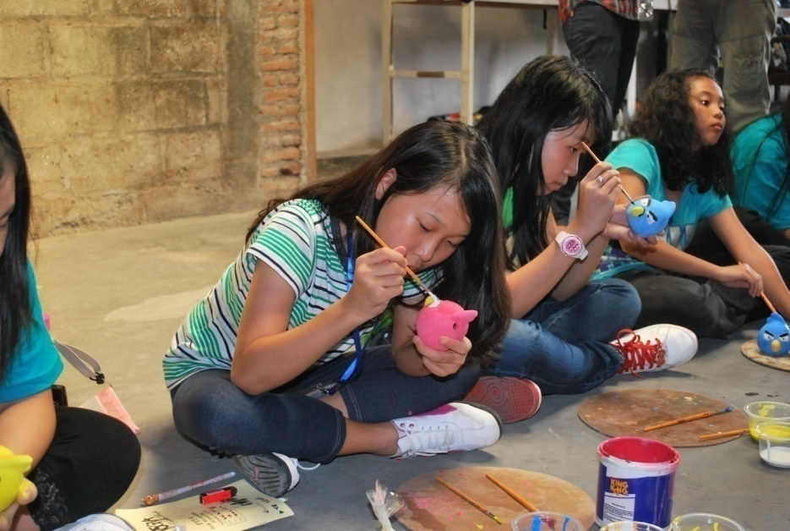
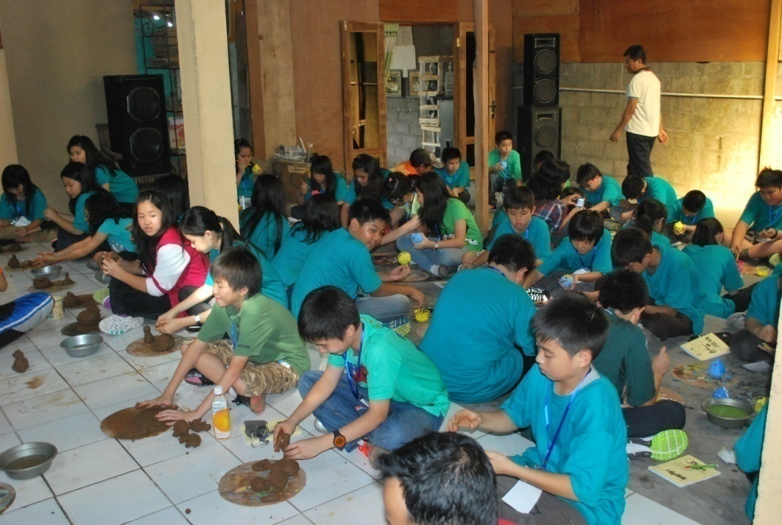
KASONGAN POTTERY MAKING

Slide 11
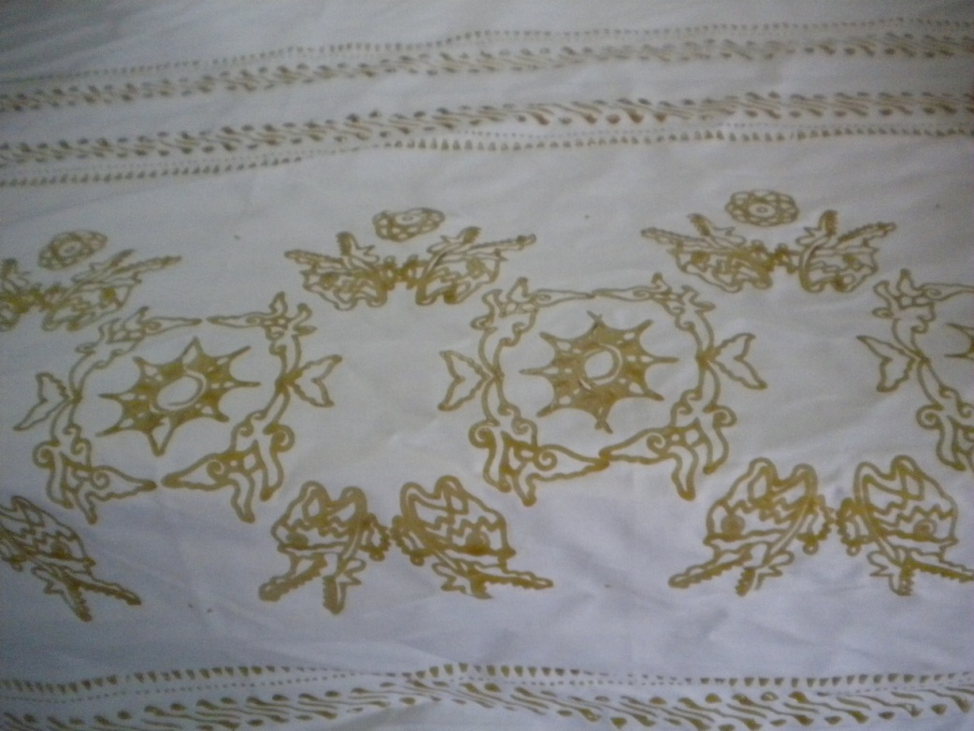
Balai pengembangan kerjinan dan batik

Slide 12
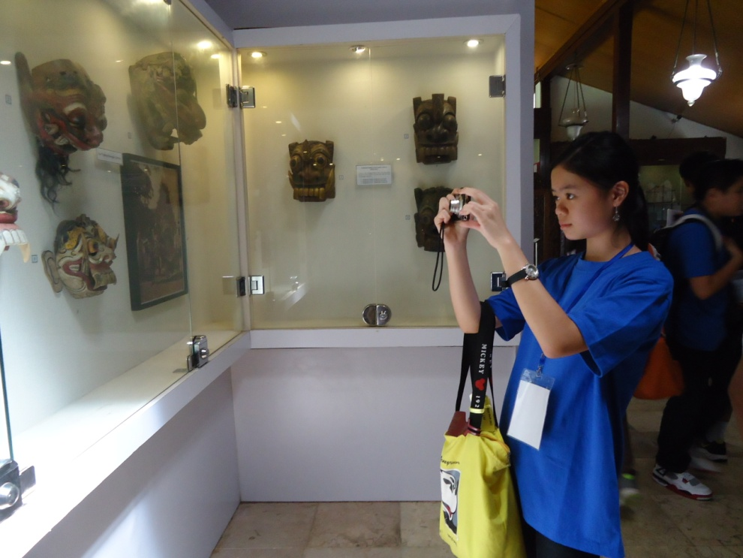
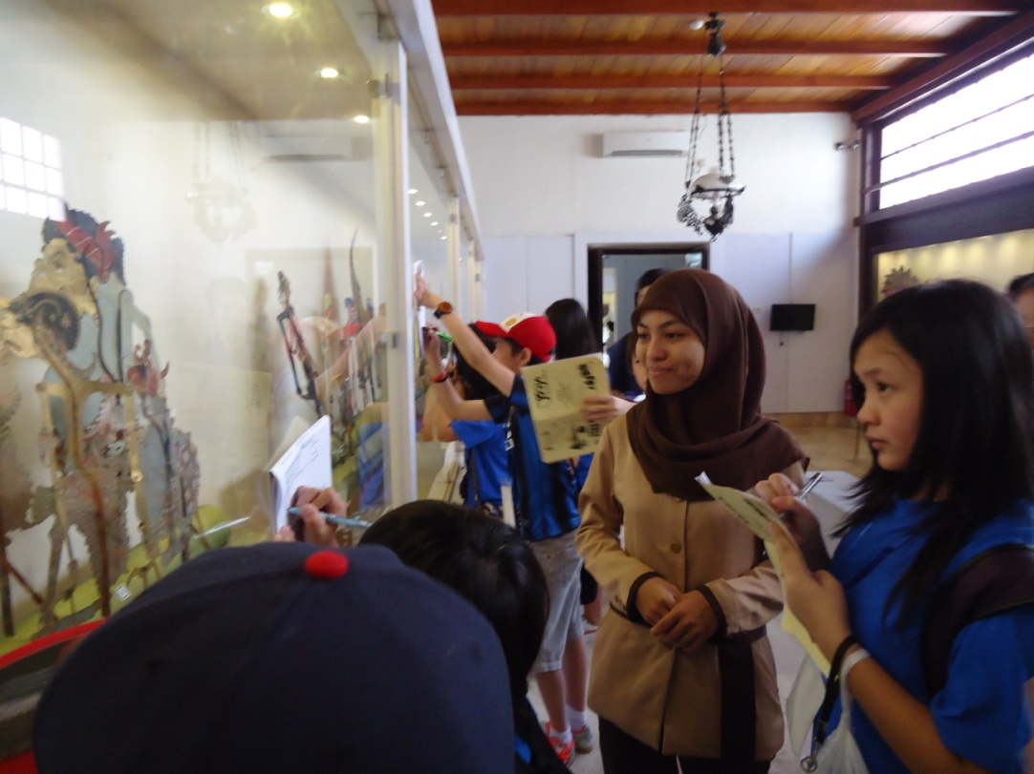
Sonobudoyo museum

Slide 13
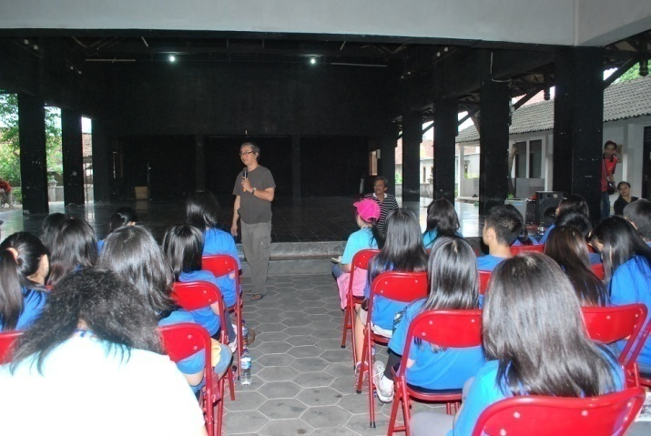
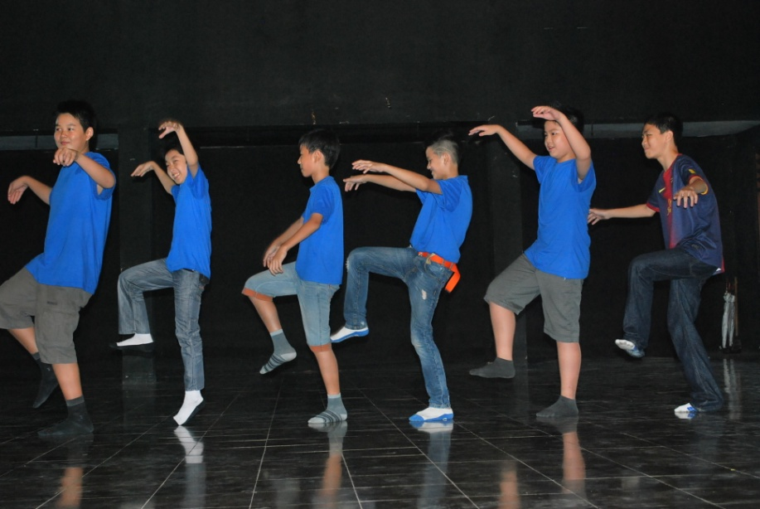
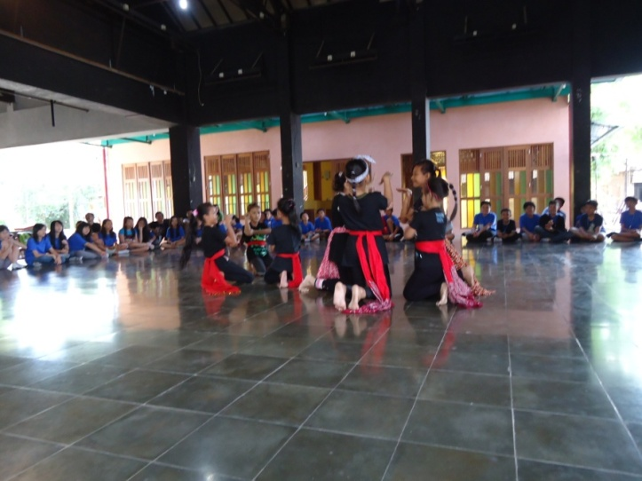
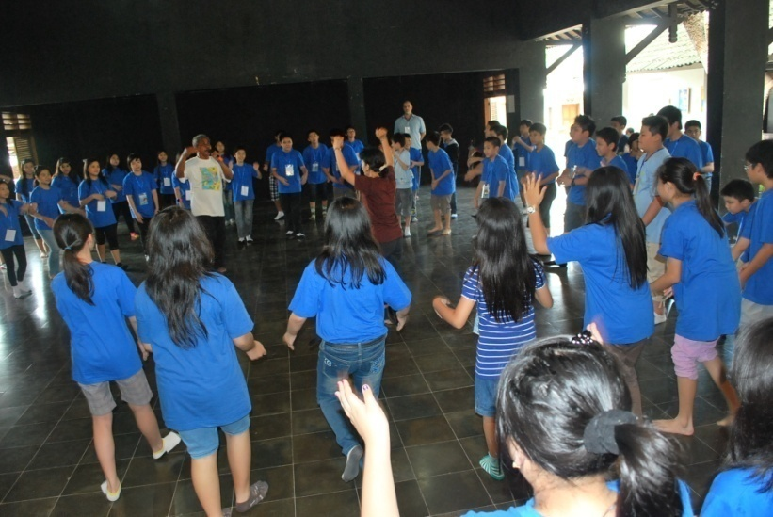
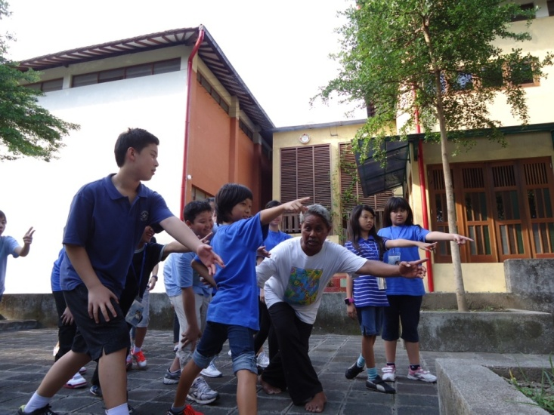
Padepokan sanggar tari dan teater bagong kusudiarjo

Slide 14
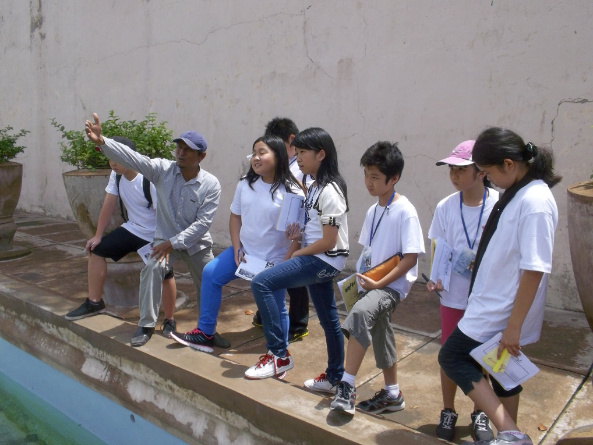
Taman sari

Slide 15
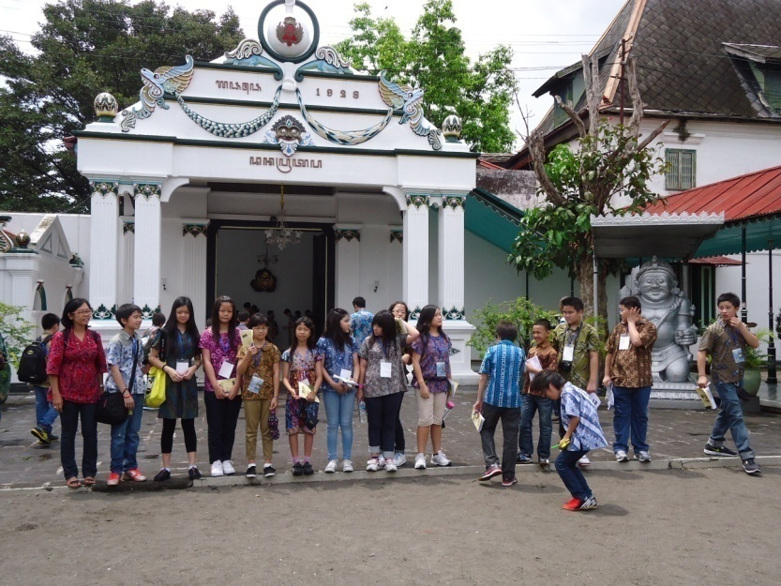
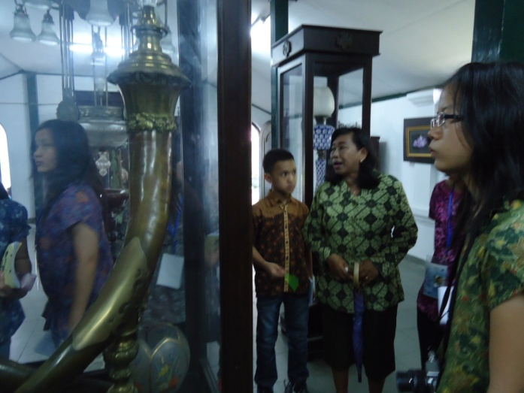
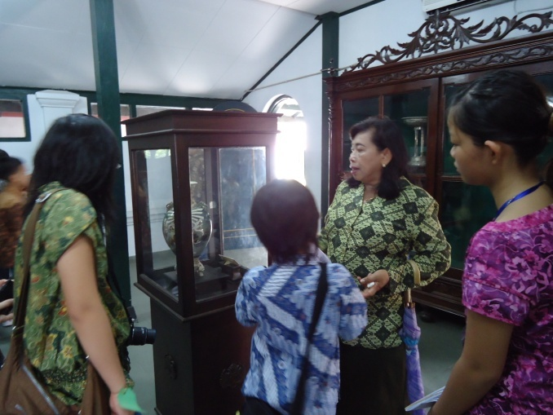
Yogyakarta palace

Slide 16
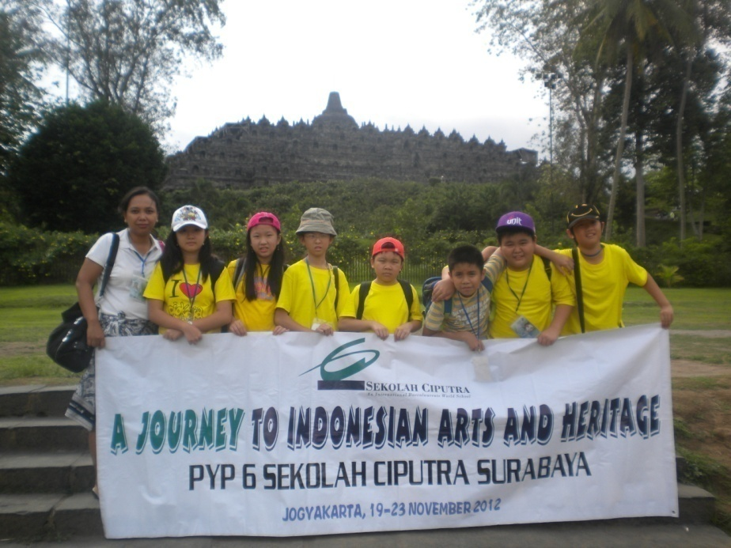
Borobudur temple

Slide 17
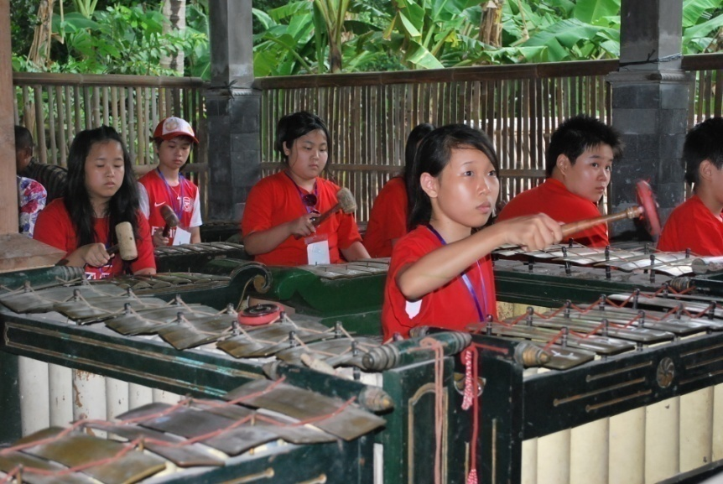
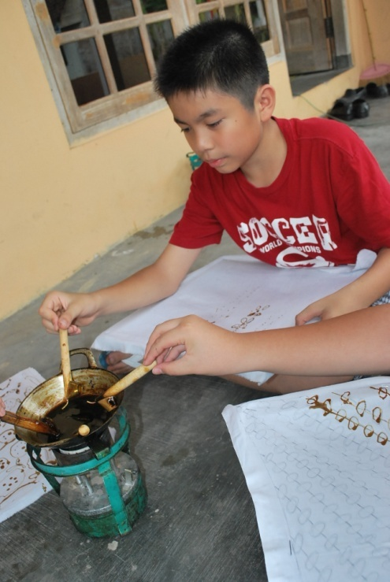
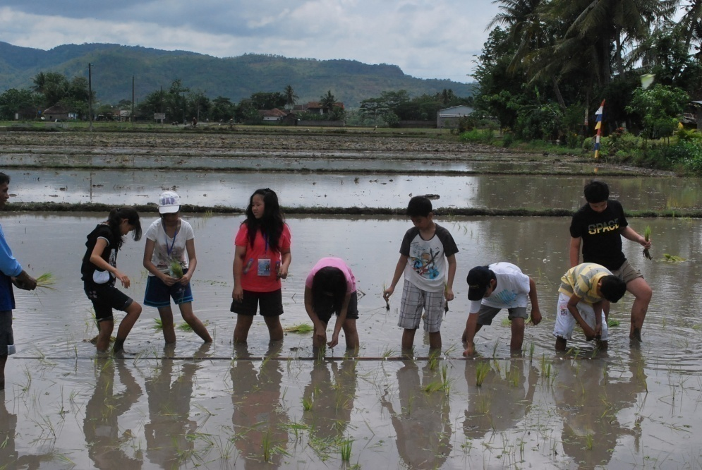
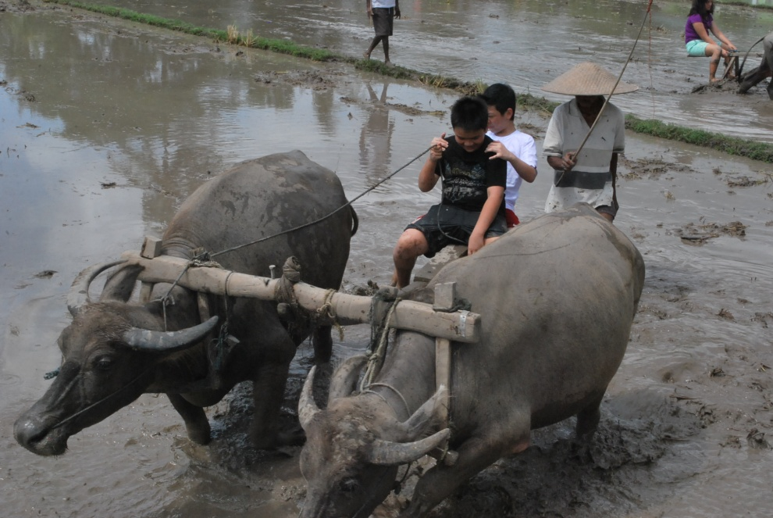
KEBON AGUNG VILLAGE

Slide 18
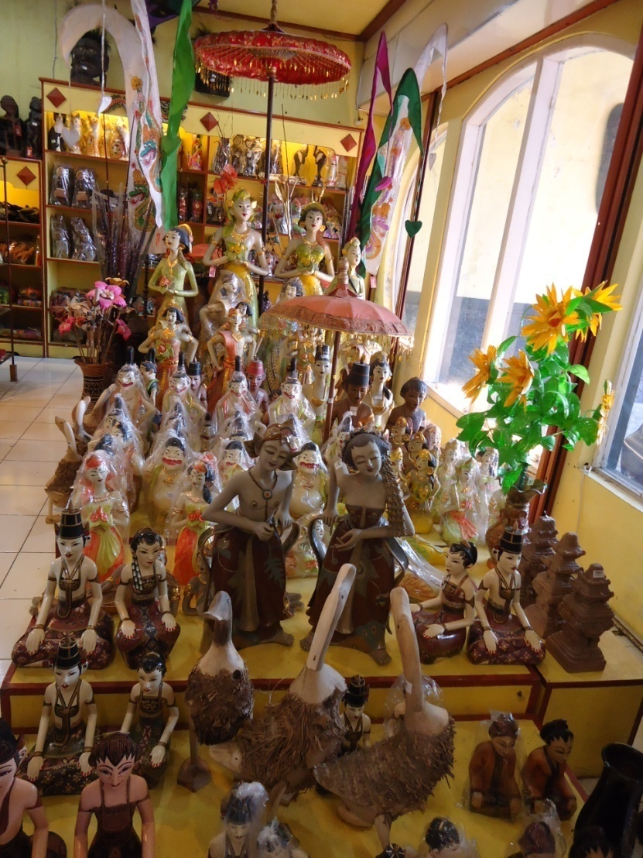
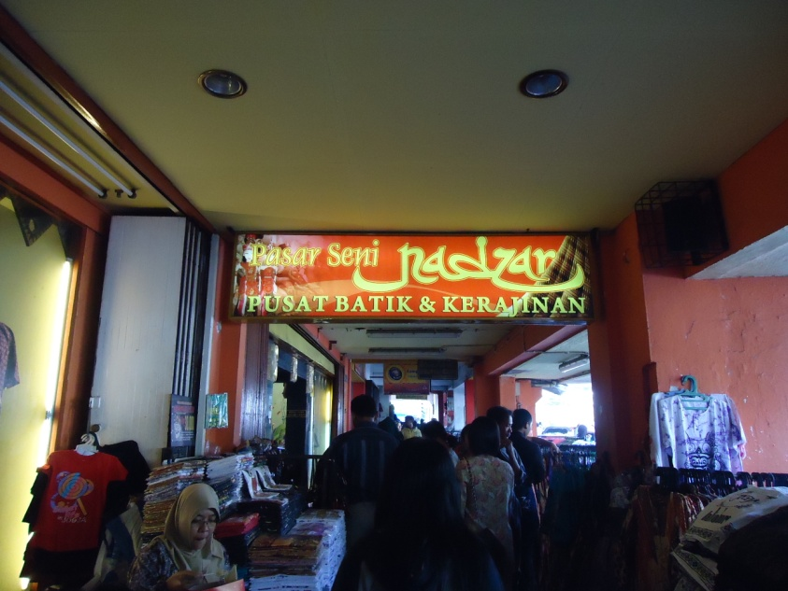
malioboro

Slide 19
Pia java (culinary)

Slide 20
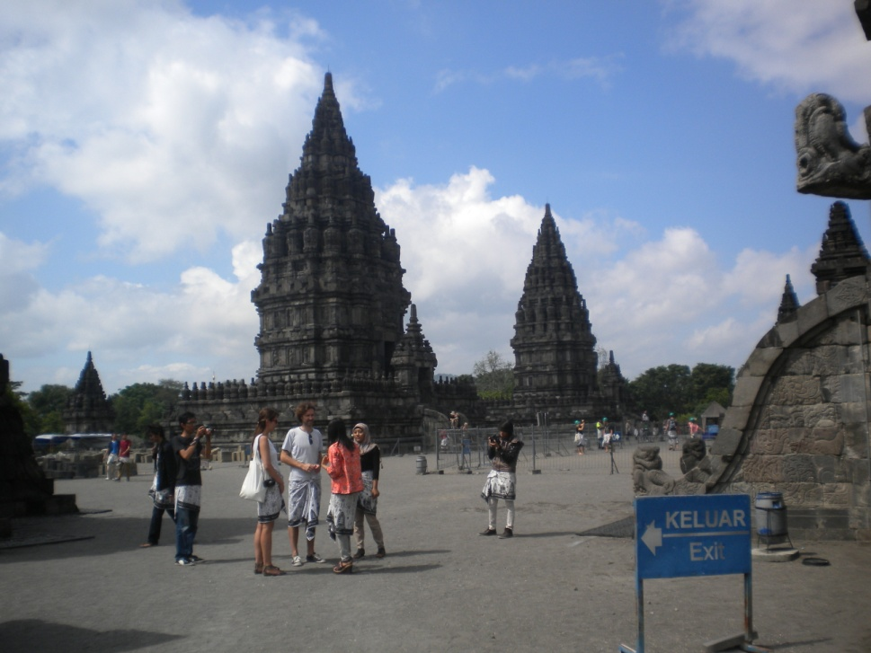
Prambanan temple

Slide 21
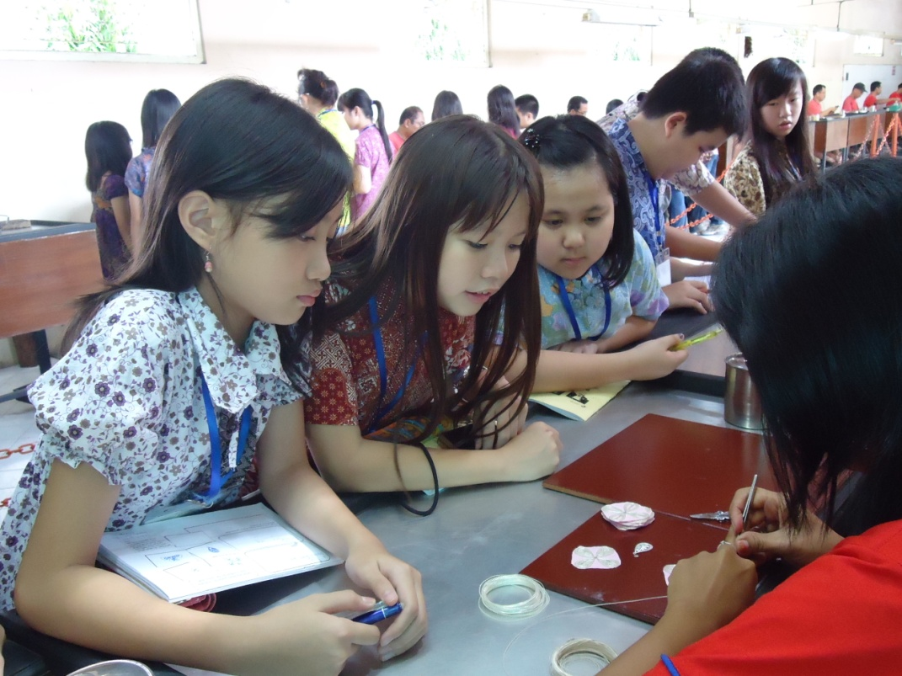
Hs silver

Slide 22
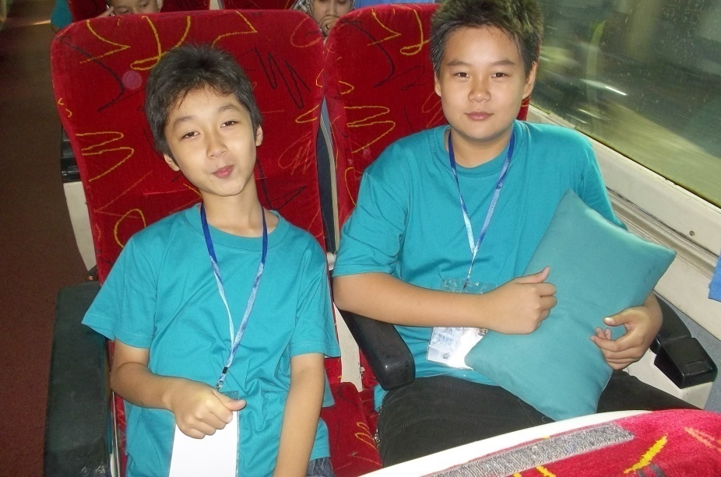
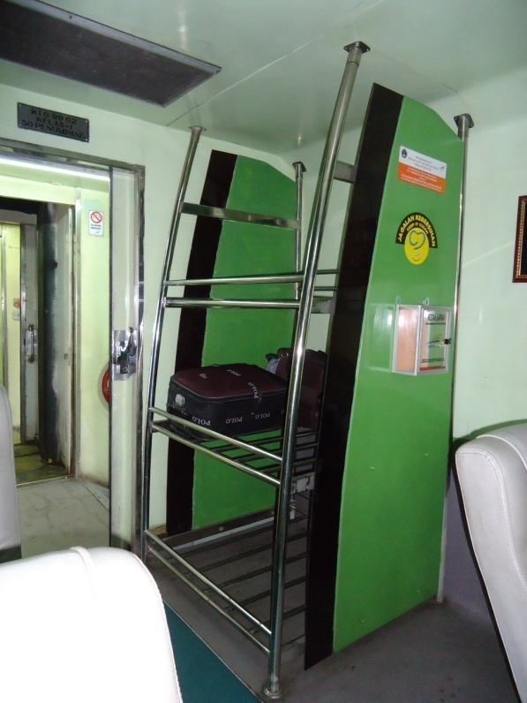
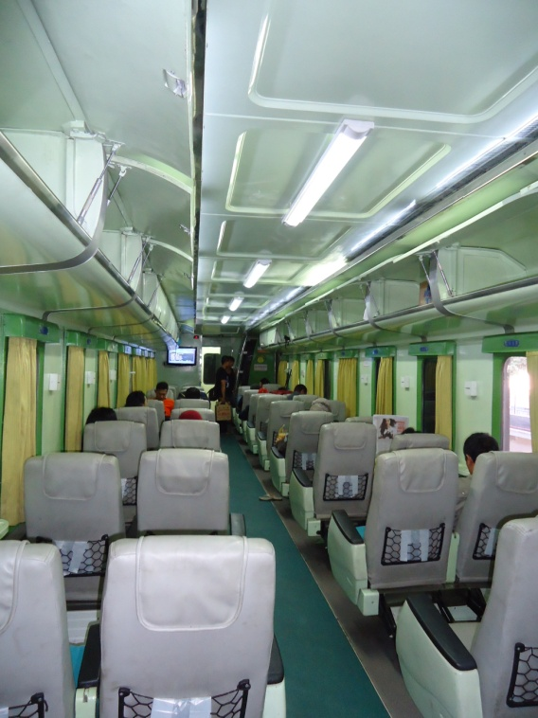
Transport (sancaka train)

Slide 23
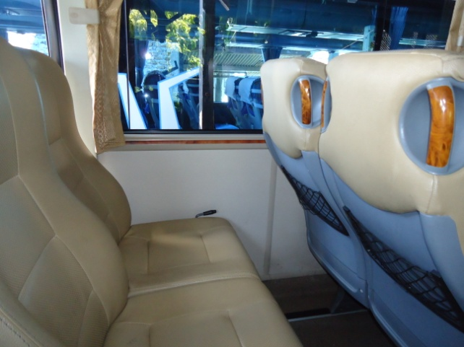
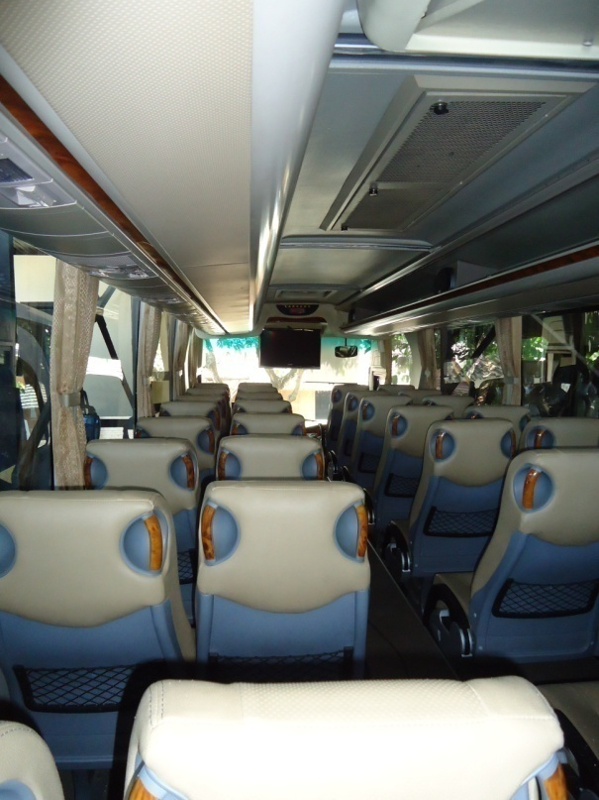
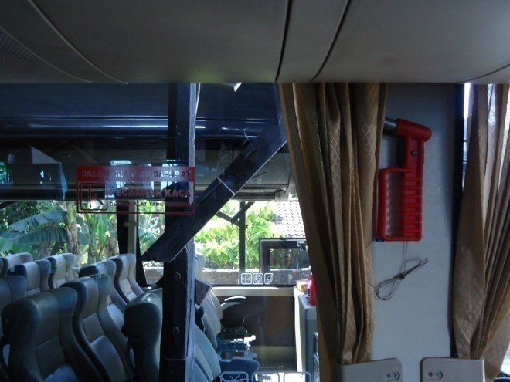
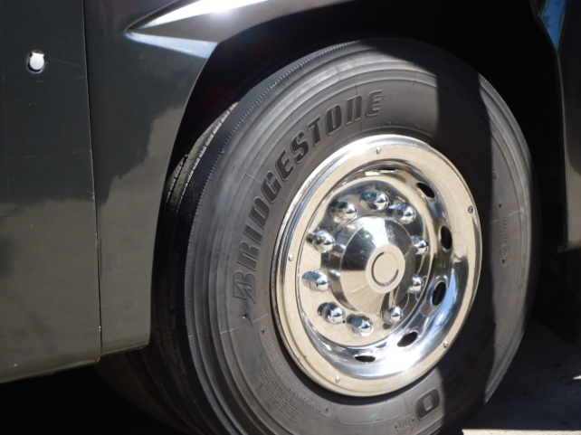
Transport (GeGe bus)

Slide 24
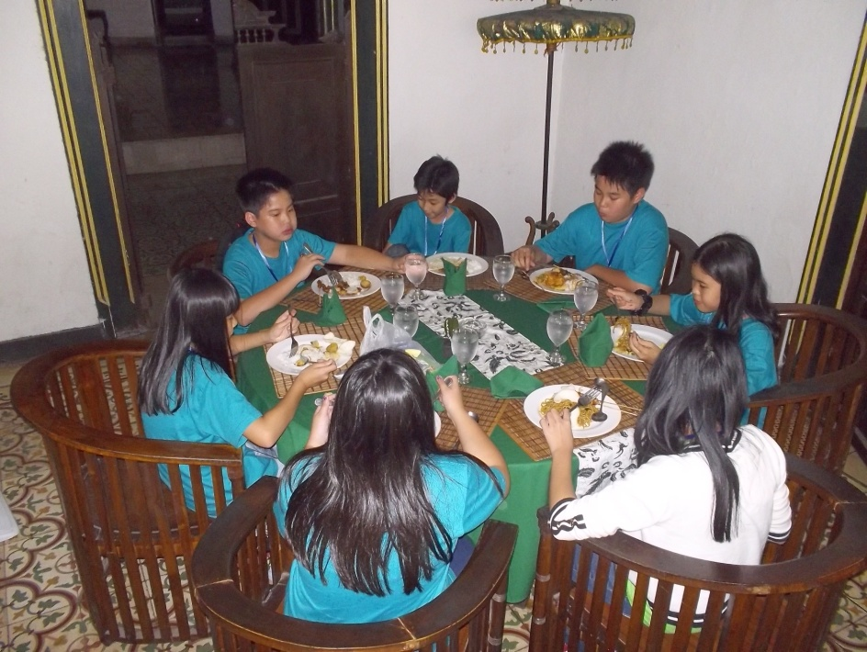
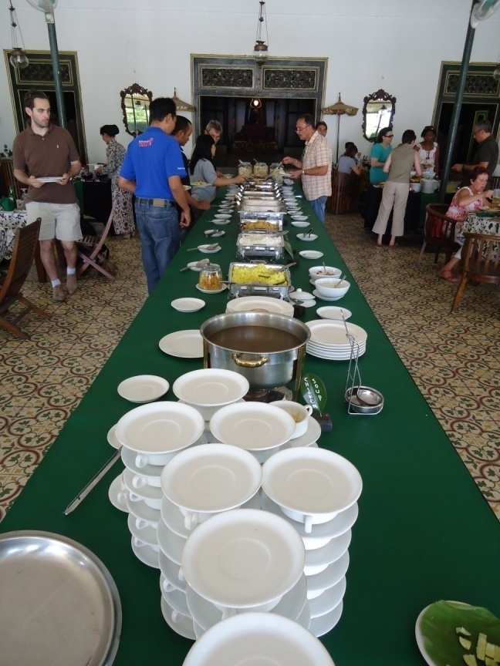
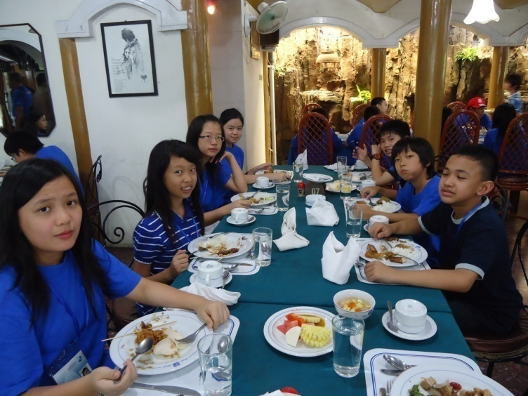
RESTAURANTs

Slide 25
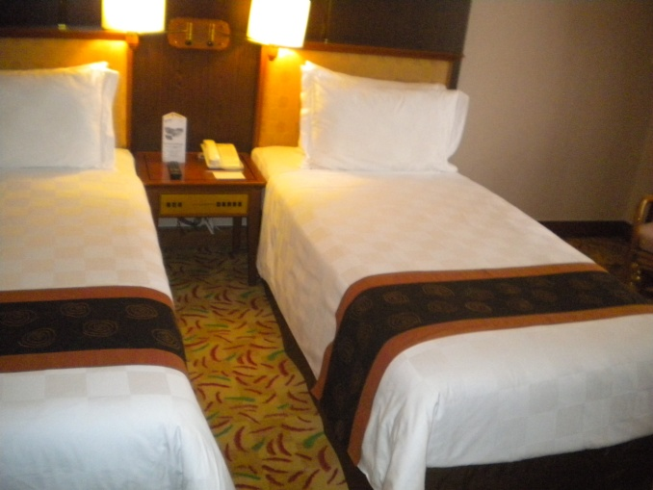
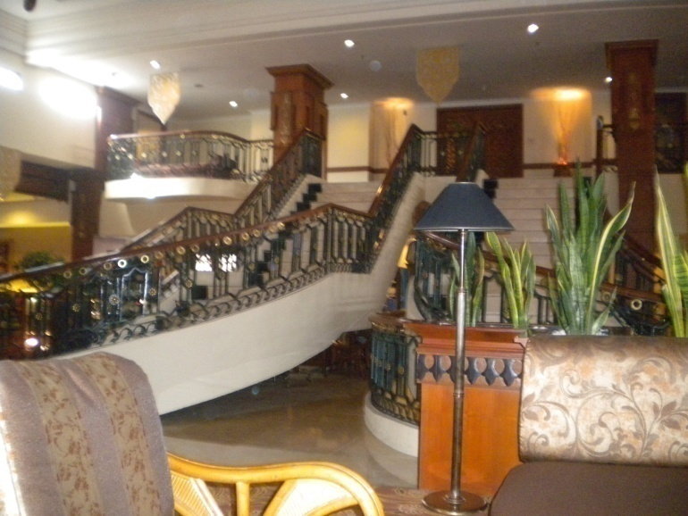
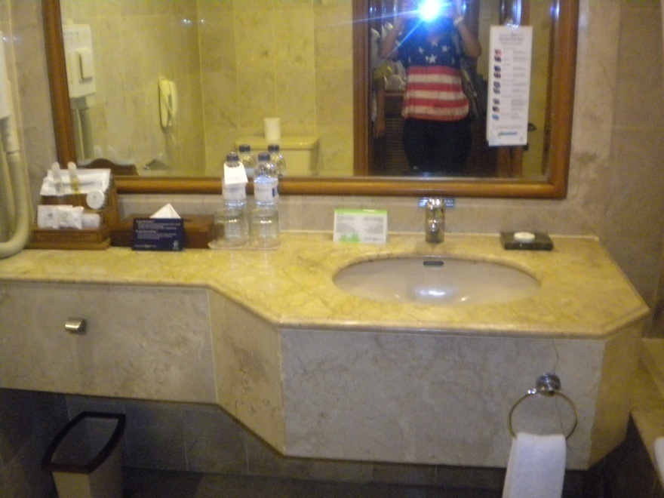
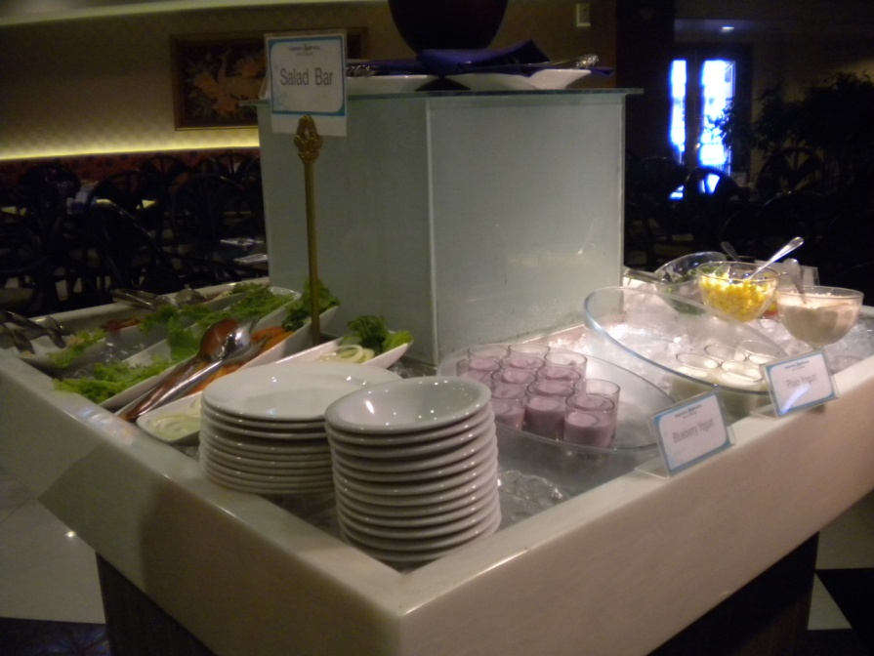
Jogja Plaza hotel

